Slide 1
Construction of a Fixed Space Maintainer
Generally consists of
Band
Loop / Archwire
Solder joint
Can be Fabricated using
Direct method
Partially Indirect method
Indirect method

Slide 2
ARMAMENTARIUM

Slide 3
Band
Important part of various appliances
Can be made of precious metal, chrome alloys
May be Preformed or Tailor Made
Preformed available in various sizes for each tooth
Band material available in sizes of
0.125 × 0.003 Anteriors
0.150 × 0.004 Bicuspids
0.180 × 0.005 Deciduous Molars
0.180 × 0.006 Permanent Molars

Slide 4
Steps in Band Formation
Separation
Band Pinching & Adaptation
Welding
Trimming & Polishing

Slide 5
Separation of teeth
Brass Wire 0.015 – 0.020 inch soft wire
Elastics
Usually kept for 24 - 48 hours

Slide 6
Band Formation
For tailor made bands !
Direct Method
Using How / Hoe Pliers
Using Band Forming Pliers
Peak Pliers
Howlett Pliers
Indirect Method

Slide 7
Extent of Band
Buccally – below level of buccal developmental grooves and not in contact with opposing tooth.
Lingually – below level of lingual groove
Proximally – above contact area but below marginal ridge.
Gingivally – Should extend around 0.5 mm inside sulcus. Follow gingival contour. No Blanching of gingiva

Slide 8
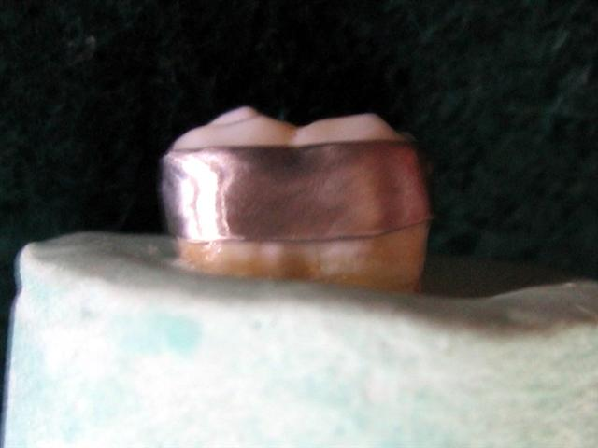
Extent of Band on Buccal side

Slide 9
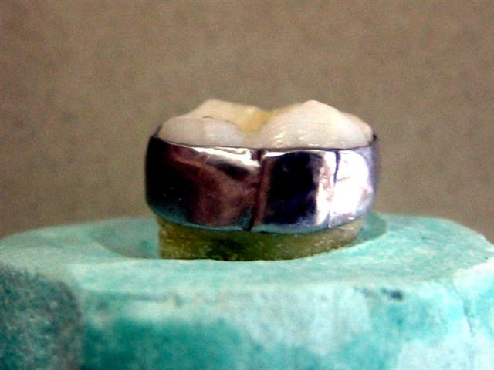
Extent of Band on Lingual side

Slide 10
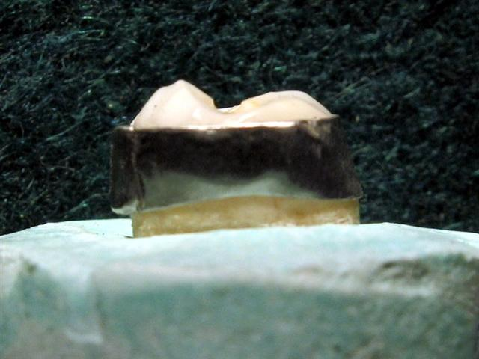
Extent of Band on Proximal side

Slide 11
Band Pinching
2 inch strip of band material cut from spool
Contoured using Johnson’s contouring pliers. Not needed if band forming pliers used
Ends of strip welded to form loop
Depending on pliers being used - inserted onto plier or tooth.
Bands pinched on lingual side.
Should be very closely adapted to tooth.

Slide 12
Band is Spot welded in 3-4 areas.
Excess band material cut off 3-4 mm away from seam
Tag folded mesially, spot welded in 3-4 areas
Festooning done
Trimming done to adjust height
Trimmed, Polished.

Slide 13
Formation of Loop / Archwire
This is done according to the type of Space Maintainer being fabricated.

Slide 14
Soldering
Refers to the joining of two metals by melting and flowing another metal between them at a temperature below the solidus temp. of either of the metals being joined.
Types – free hand, investment soldering

Slide 15
Finishing & Polishing
Space Maintainer trimmed using Heatless stone
Space Maintainerooth edges required
Polished using Rubber Wheel

Slide 16
Band & Loop Space Maintainer

Slide 17
Band & Loop Space Maintainer
Fixed Unilateral Type
Used in Posterior segments
E.g. Maintain space of 1st Deciduous Molar before eruption of 1st premolar

Slide 18
Technique of Construction: Band & Loop Space Maintainer
Select a band / Adapt a band to tooth posterior to lost tooth
Place band on tooth
Make an impression using Alginate
Remove band, seat in impression, stabilize it
Pour the cast
Adapt U loop on cast – 19 G, round SS wire
Stabilize U loop with dental plaster
Solder, finish & polish
Cementation of Space Maintainer

Slide 19
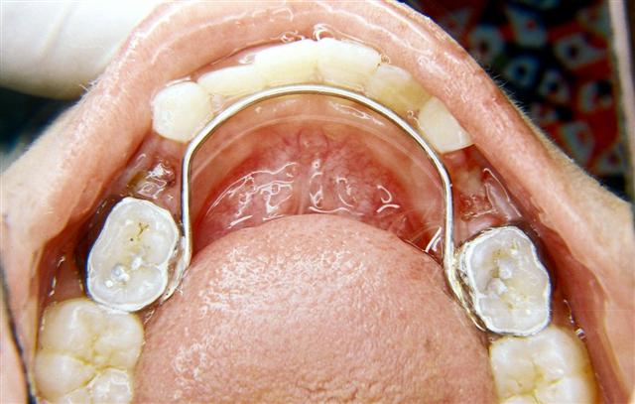
Lingual Arch Space Maintainer

Slide 20
Lingual Arch Space Maintainer
Fixed Bilateral Space Maintainer
Used in lower arch
Can Prevent Lingual tipping of teeth as well as A-P movement
Used only after eruption of permanent incisors. Otherwise Band & loop Space Maintainer used.
Modifications: with canine spurs, removable with precision molar tubes, with U loops
Wire should be passive

Slide 21
Advantages of Lingual Arch Space Maintainer
Holds molar position distally and the incisors labially
Prevents incisor collapse
Preserves canine space, e.g. in serial extraction.

Slide 22
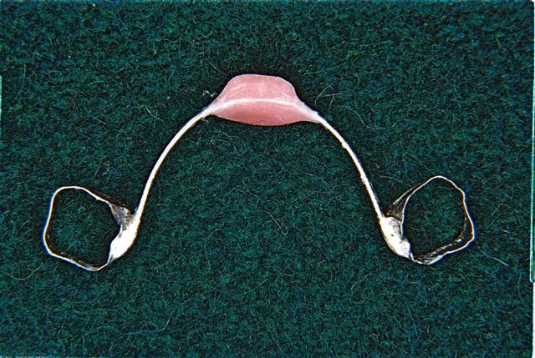
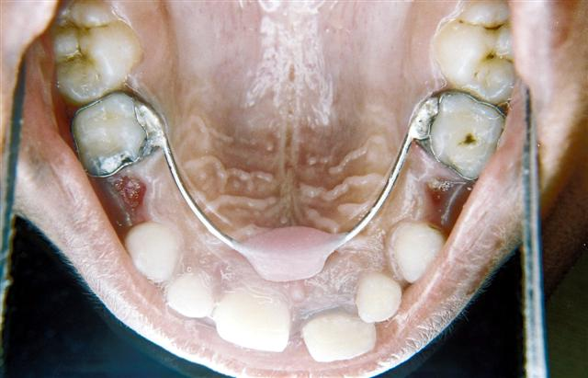
Nance Palatal Arch

Slide 23
Nance Palatal Arch
Also called Nance Holding Arch
Used in upper arch
Used when there is bilateral loss of primary posterior teeth

Slide 24
Disadvantages of Nance Palatal Arch Space Maintainer
Soft Tissue irritation
Palatal tissue hypertrophy if oral hygiene not maintained.

Slide 25
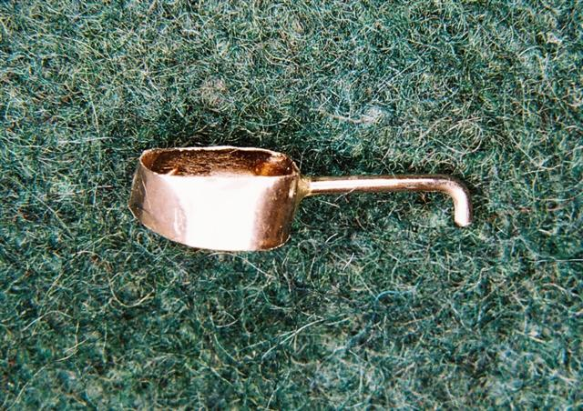
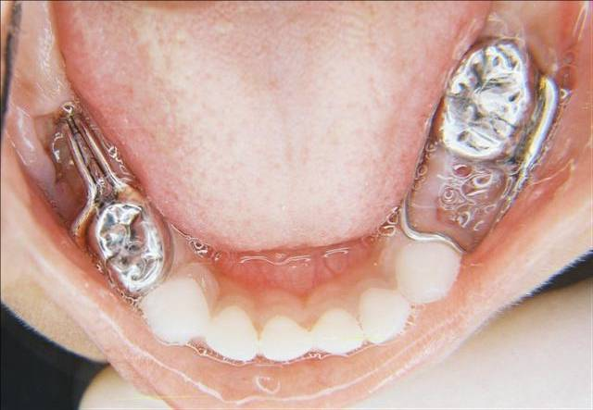
Distal Shoe Space Maintainer

Slide 26
Distal Shoe Space Maintainer
Also called Willets Guiding Shoe Appliance, Intra-alveolar App.
Used when there is premature loss of ‘E’ before eruption of ‘6’
Main objective is to guide the erupting ‘6’ to its correct position.

Slide 27
Complications of Distal Shoe Space Maintainer
Difficult to construct accurate appliance
Acts as a foreign body
Need for periodic evaluation for correct positioning
Possible breakage and subsequent trauma

Slide 28
Contraindications of Distal Shoe Space Maintainer
Several missing teeth, lack of abutment.
Certain medical conditions like Rheumatic heart disease, blood disorder. In these conditions, use a removable app. to apply pressure on ridge just mesial to ‘6’ ; OR
Regain space later on.

Slide 29
Band & Bar Type Space Maintainer
Fixed type of Space Maintainer
Teeth on either side of space are banded.
A Bar is soldered on to these.
Is the simplest type of Functional Space Maintainer

Slide 30
Trans Palatal Arch Space Maintainer
Used to maintain space when there is individual / bilateral loss of maxillary primary molars
Bands adapted onto molar on each side
Working model prepared
A 19 gauge wire adapted along palatal surface avoiding contact with soft tissue
Soldering, finishing and polishing done.

Slide 31
Bonded Type of Space Maintainer

Slide 32
Bonded Type of Space Maintainer
Easy to prepare type of Space Maintainer
Brackets bonded onto tooth on either side of space
Arch wire ligated.

Slide 33
Open Coil Space Regainer

Slide 34
Open Coil Space Regainer
Active Space maintainer.
Similar to Band & Loop Space Maintainer, but the loops are Parallel, are inserted into buccal tubes, and the loop has a spring around it
Spring pushes loop out of buccal tube and thus regains space

Slide 35
Recall and Maintenance of Space Maintainer
All Space Maintainer Patients have to be under recall program
Removable Space Maintainer have to be checked to see their fit, checked to see if they hamper growth
Fixed Space Maintainer have to be removed every 3-4 months and checked for DC and then re-cemented.
GIC recommended for cementation.
If any primary tooth anchoring Space Maintainer is shedding off, then another suitable Space Maintainer has to be constructed.

